Slide 1


Michele Chersich
07.07.2025

Slide 2

Outline
Executive Summary
Introduction
Methodology
Results
Conclusion
Appendix

Slide 3
Executive Summary
Preventing unsuccessful rocket launches can save aerospace companies millions of dollars for each launch. To this end, we identify the key features of a successful launch and devise a machine learning model to predict launch success or failure. Following the data science methodology, we do data collection, data wrangling, exploratory data analysis, data visualisation, and machine learning prediction.
Including features like payload mass, number of flights, orbit type, launch site location, the use of specific components (e.g. gridfins and legs), the reuse of rocket components, we tested several machine learning models to predict successful vs. unsuccessful launches.

Slide 4
Introduction
Space X advertises Falcon 9 rocket launches on its website with a cost of 62 million dollars; other providers cost upward of 165 million dollars each. Much of the savings is because Space X can reuse the first stage.
If we can determine if the first stage will land, we can determine the cost of a launch. This information can be used if an alternate company wants to bid against SpaceX for a rocket launch.

Slide 5

Section 1

Slide 6
Methodology
Executive Summary
Data collection methodology:
HTTP request to SpaceX API
Perform data wrangling
Convert launch outcomes from string to binary representation (1 for success, 0 for failure)
Impute missing payload mass values with the mean
Perform exploratory data analysis (EDA) using visualisation and SQL
Perform interactive visual analytics using Folium and Plotly Dash
Perform predictive analysis using classification models
Using the Scikit-Learn library, we standardise the data; split the dataset into training and test sets; perform GridSearch to find the best set of hyper-parameters, then train the classifier; evaluate the model’s performance as training and test accuracy; repeat for different classification models and compare performance

Slide 7
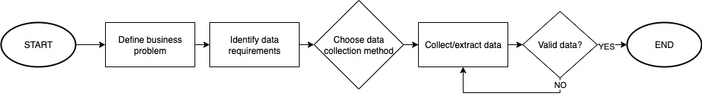
Data Collection
The datasets are collected via web requests to the SpaceX API.
Data collection process:
Define business problem: predicting launch outcome
Identify data requirements: booster name, launch site name and location, payload mass and orbit type, core related data, and launch outcome
Choose data collection method: SpaceX API
Collect data from SpaceX API
Validate data: check completeness and accuracy

Slide 8
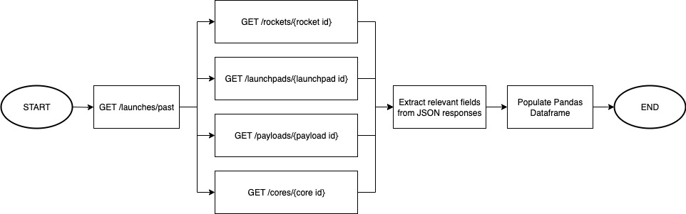
Data Collection – SpaceX API
Call the SpaceX API: retrieve launches, then for each launch retrieve rocket, launchpad, payload, and core data; extract relevant data from JSON responses and create a Pandas Dataframe
https://github.com/k33rs/data-science-capstone/blob/main/1-data/spacex-data-collection-api-v2.ipynb

Slide 9
Data Collection - Scraping
Fetch the HTML list of Falcon 9 launches (https://en.wikipedia.org/w/index.php?title=List_of_Falcon_9_and_Falcon_Heavy_launches&oldid=1027686922); parse HTML content with BeautifulSoup; extract column names from table header; read table data and populate Pandas Dataframe
https://github.com/k33rs/data-science-capstone/blob/main/1-data/spacex-webscraping.ipynb

Slide 10
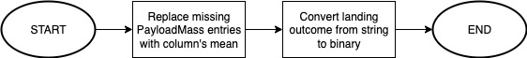
Data Wrangling
Replace missing PayloadMass entries with column’s mean; convert landing Outcome from string (“True …” for success, else failure) to binary (1 for success, 0 for failure)
https://github.com/k33rs/data-science-capstone/blob/main/1-data/spacex-data-wrangling-v2.ipynb

Slide 11
EDA with Data Visualization
Several scatter plots show relationship between variables (e.g. FlightNumber vs PayloadMass, FlightNumber vs LaunchSite, PayloadMass vs LaunchSite, etc.), highlighting launch success or failure for each data point; a bar plot is used to display the success rate for each Orbit type; a line chart displays the yearly success rate from 2010 to 2020
https://github.com/k33rs/data-science-capstone/blob/main/2-exploratory-data-analysis/spacex-eda-dataviz-v2.ipynb

Slide 12
EDA with SQL
The following SQL queries are performed:
Display the names of unique launch sites in the space mission
Display 5 records where launch sites begin with the string ‘CCA'
Display the total payload mass carried by boosters launched by NASA (CRS)
Display the average payload mass carried by booster version F9 v1.1
List the date when the first successful landing outcome in ground pad was achieved
List the name of the boosters which have success in drone ship and have payload mass greater than 4000 but less than 6000
List the total number of success and failure mission outcomes
List all the booster versions that have carried the maximum payload mass
List the records which will display month names, failure landing outcomes in drone ship, booster versions, and launch site for the months in year 2015
Rank the count of landing outcomes between the date 2010-06-04 and 2017-03-20, in descending order
https://github.com/k33rs/data-science-capstone/blob/main/2-exploratory-data-analysis/spacex-eda-sqlite.ipynb

Slide 13
Build an Interactive Map with Folium
We mark launch sites on the map with circles, markers, marker clusters, and poly lines
Circles highlight launch site locations, markers label locations with launch site names; marker clusters are used to display each launch site’s missions with green and red icons (green for success, red for failure); poly lines are drawn to highlight the distance between launch sites and nearest points of interest (e.g. coastline, city, railway, highway, etc.)
https://github.com/k33rs/data-science-capstone/blob/main/3-visual/spacex-launch-site-location-v2.ipynb

Slide 14
Build a Dashboard with Plotly Dash
The upper part of the dashboard features a dropdown menu and a pie chart: the options are either all launch sites or individual launch sites: the former displays each site's success rate out of all successful launches, the latter shows each launch site's success vs failure rate (1 for success, 0 for failure)
The bottom part features a slider and a scatter plot, which plots payload mass vs launch outcome for the current dropdown selection, with booster version as hue; the slider allows to select the range of the payload mass (i.e. x axis)
The pie chart allows to rank successful launch sites, while the scatter plot investigates a correlation between payload mass and launch outcome
https://github.com/k33rs/data-science-capstone/blob/main/3-visual/spacex_dash_app.py

Slide 15
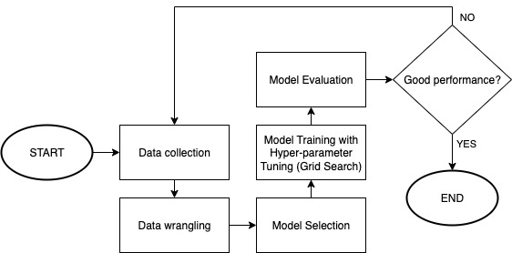
Predictive Analysis (Classification)
Tested four classification models: Logistic Regression, Support Vector Machine, Decision Tree, and K-Nearest Neighbors; found the best hyper-parameters for each model via grid search, i.e. trained each model multiple times and retained the instance with the best parameters; evaluated each model’s performance based on prediction accuracy on test data
N.B. In addition to what previously done in the data wrangling phase, we standardise the input, and split it into training and test sets
https://github.com/k33rs/data-science-capstone/blob/main/4-machine-learning/spacex-machine-learning-prediction-v1.ipynb

Slide 16
Results: Exploratory data analysis
Success rate grows with the number of flights
Payload mass needs to be within some limit to control risks
ES-L1, GEO, HEO, and SSO orbit types have best success rate
No correlation between flight number and orbit type with respect to success rate
The yearly success rate surged from 2013 to 2017

Slide 17
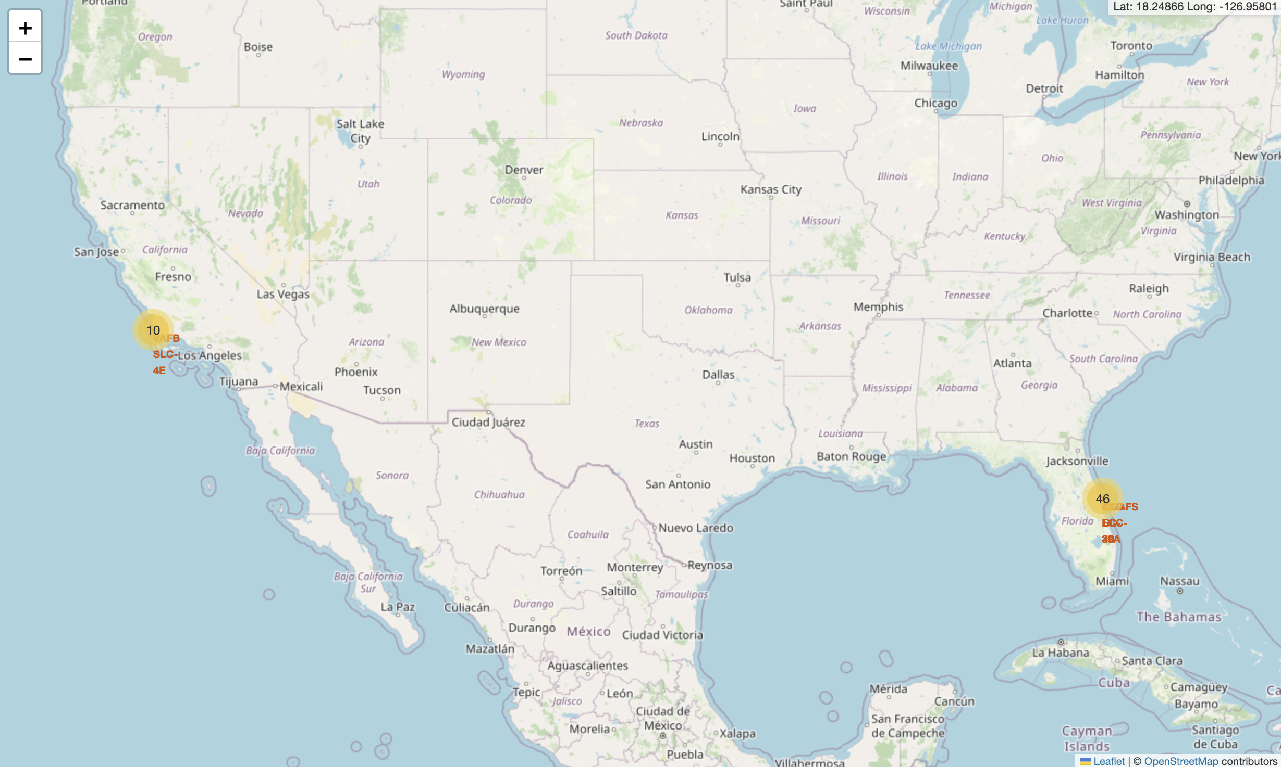
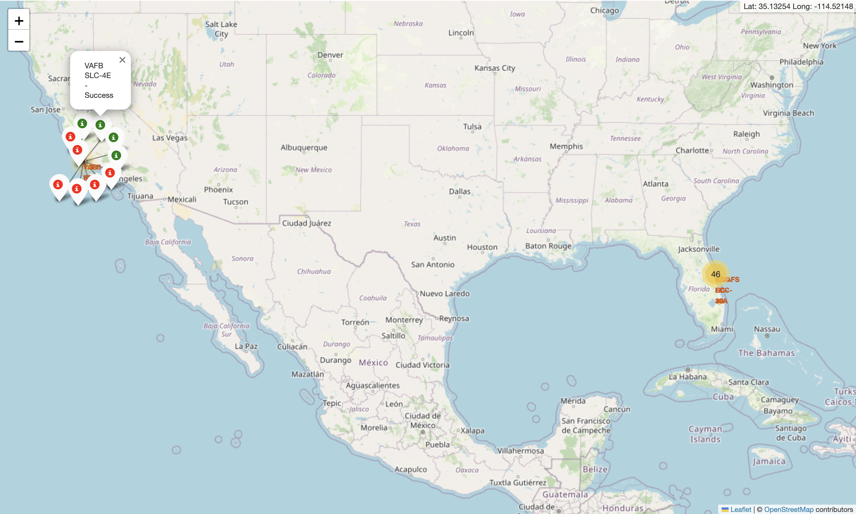
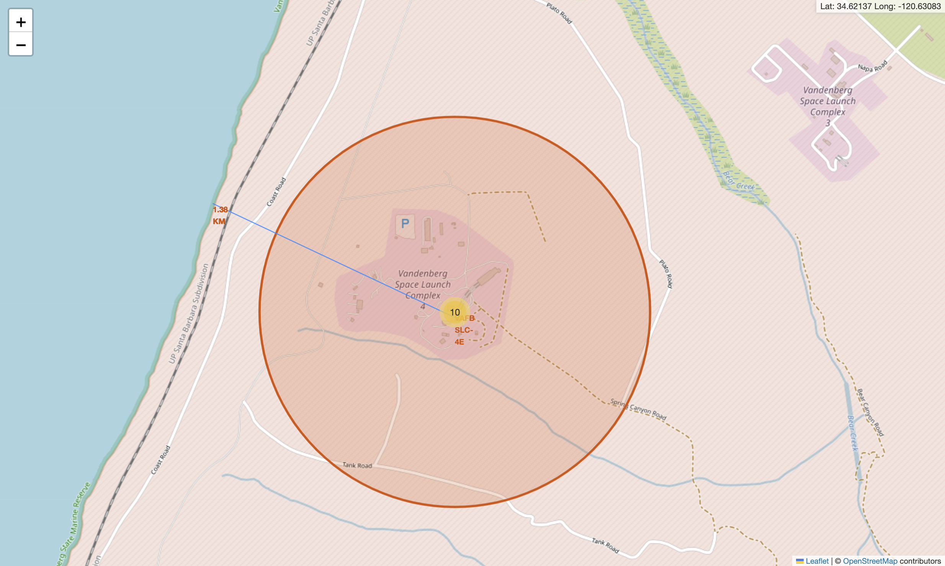
Results: Interactive analytics demo

Slide 18
Results: Predictive Analysis
All tested models (Logistic Regression, Decision Trees, Support Vector Machine, and K-Nearest Neighbors) achieve an accuracy score of 83.33% on test data
The performance is good for all models, i.e. any of these is a good choice

Slide 19

Section 2

Slide 20
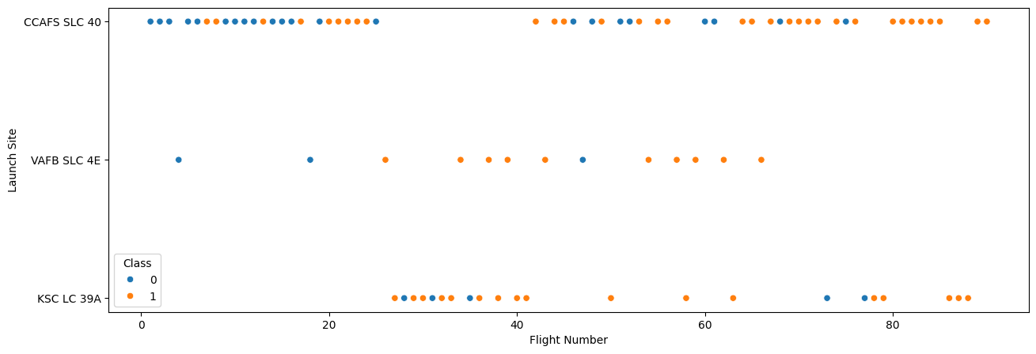
Flight Number vs. Launch Site
Mission outcome (1 for success, 0 for failure) as a function of number of flights and launch sites
We observe a positive correlation between number of flights and success rate

Slide 21
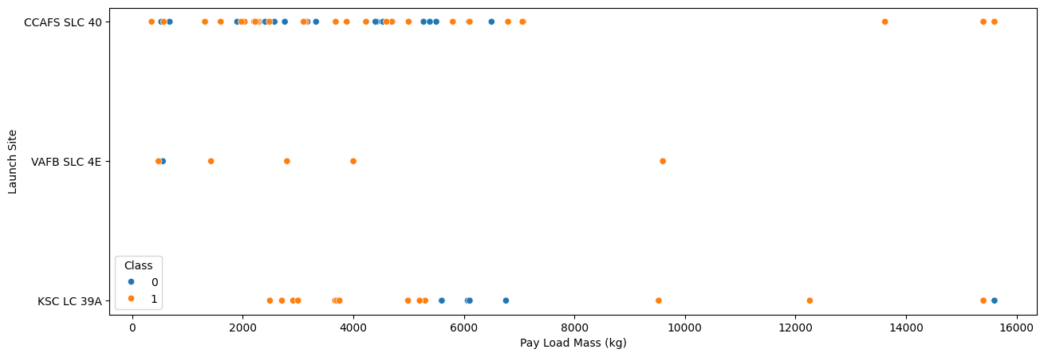
Payload vs. Launch Site
Mission outcome (1 for success, 0 for failure) as a function of payload mass and launch sites
We observe higher success rate when payload does not exceed some threshold (e.g. KSC LC 39A below 6000)
Very few launches have high payload (i.e. above 8000)

Slide 22
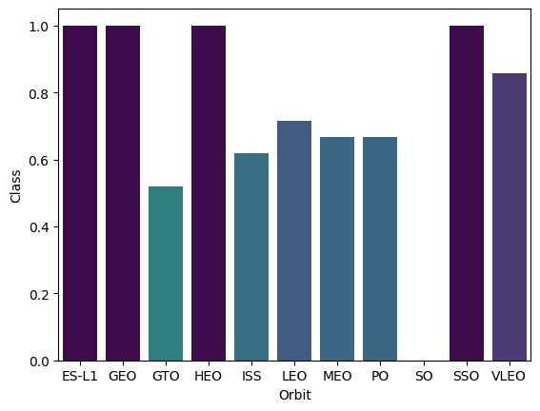
Orbit Type vs. Success Rate
A bar chart to quantify success rate for each orbit type
ES-L1, GEO, HEO, and SSO have maximum success rate, followed by VLEO, LEO, etc.

Slide 23
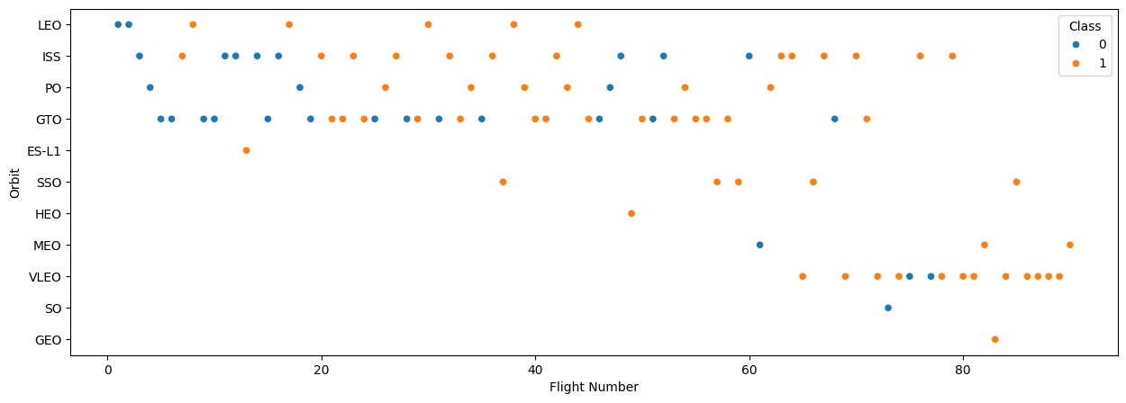
Flight Number vs. Orbit Type
In the LEO orbit, the success appears to be correlated to the number of flights
No relationship in the GTO orbit
Therefore, the correlation between number of flights and success is not affected by the orbit type

Slide 24
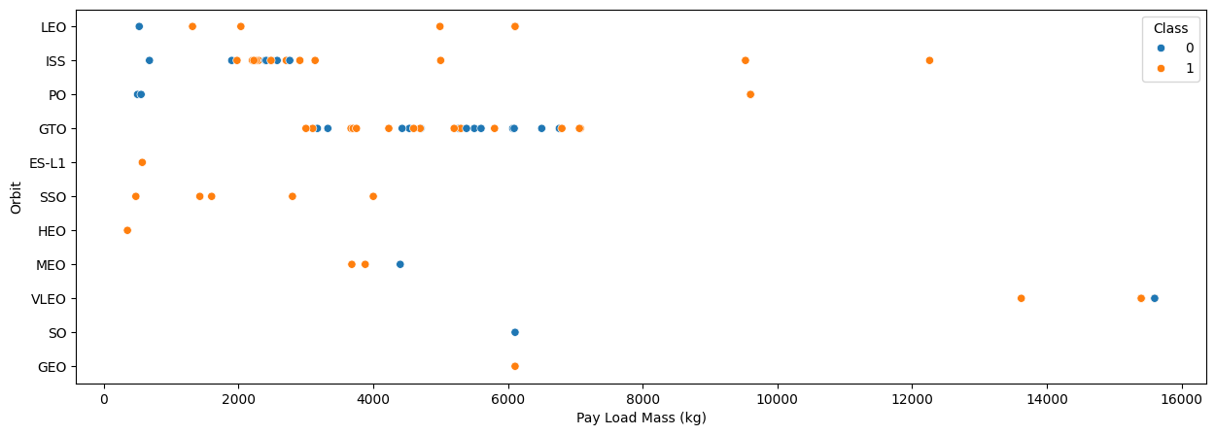
Payload vs. Orbit Type
With heavy payloads, the success rate is higher for LEO, ISS, and PO
For GTO, no correlation; for other orbits, not enough data points
Therefore, correlation is possible but not certain

Slide 25
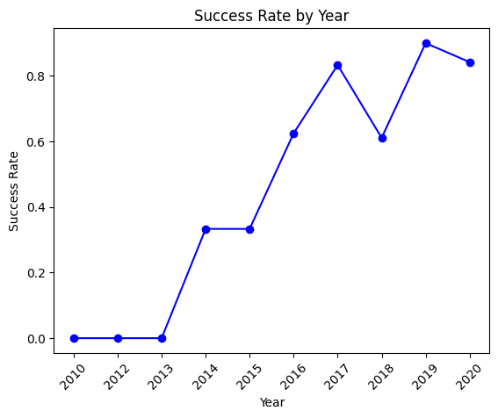
Launch Success Yearly Trend
Success rate from 2010 to 2013 was stable
Surged from 2013 to 2017, with a plateau from 2014 to 2015

Slide 26
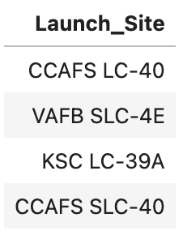
All Launch Site Names
Find the names of the unique launch sites
There are many records in the SQL table, so the “Launch_Site” column contains repetitions
We use the “distinct” keyword to remove duplicates (see Appendix A)

Slide 27
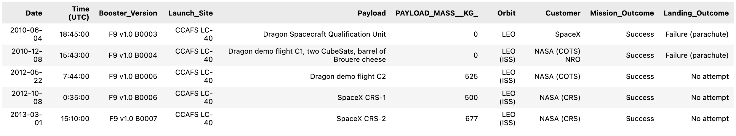
Launch Site Names Begin with 'CCA'
Find 5 records where launch sites begin with `CCA`
Use a regular expression to filter launch sites, then select the first 5 records (see Appendix B)

Slide 28
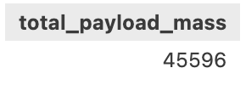
Total Payload Mass
Calculate the total payload carried by boosters from NASA
Filter the customer column for ‘NASA (CRS)’, then sum payload mass entries (see Appendix C)

Slide 29
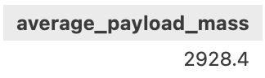
Average Payload Mass by F9 v1.1
Calculate the average payload mass carried by booster version F9 v1.1
Filter the booster version column for ‘F9 v1.1’, then average payload mass entries (see Appendix D)

Slide 30
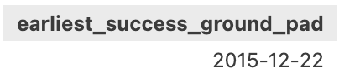
First Successful Ground Landing Date
Find the dates of the first successful landing outcome on ground pad
Filter landing outcome for ‘Success (ground pad)’, then select the minimum date (see Appendix E)

Slide 31
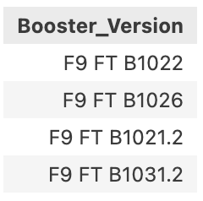
Successful Drone Ship Landing with Payload between 4000 and 6000
List the names of boosters which have successfully landed on drone ship and had payload mass greater than 4000 but less than 6000
Filter landing outcome for ‘Success (drone ship)’ and payload mass between 4000 and 6000; booster version contains duplicates, so use ‘distinct' keyword for selection (see Appendix F)

Slide 32
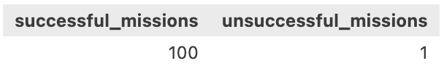
Total Number of Successful and Failure Mission Outcomes
Calculate the total number of successful and failure mission outcomes
We must perform two queries, so we nest them; we use regular expressions to filter mission outcome for success and failure, then count the number of entries for each (see Appendix G)

Slide 33
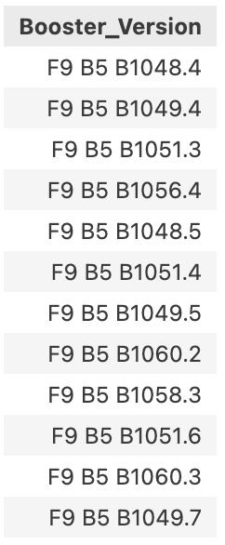
Boosters Carried Maximum Payload
List the names of the booster which have carried the maximum payload mass
Filter payload for maximum value by using a nested query, then select booster version (see Appendix H)

Slide 34
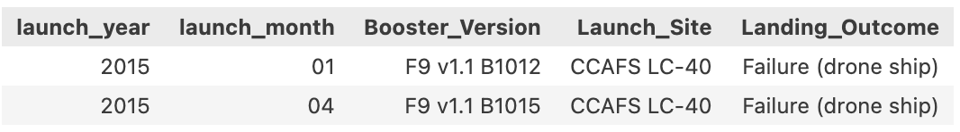
2015 Launch Records
List the failed landing_outcomes in drone ship, their booster versions, and launch site names in year 2015
Filter date for year 2015 using substr function, and filter landing outcome for ‘Failure (drone ship)’, then select columns (see Appendix I)

Slide 35
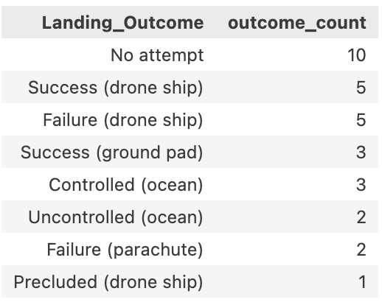
Rank Landing Outcomes Between 2010-06-04 and 2017-03-20
Rank the count of landing outcomes (such as Failure (drone ship) or Success (ground pad)) between the date 2010-06-04 and 2017-03-20, in descending order
Filter date between 2010-06-04 and 2017-03-20, group by landing outcome, then select landing outcome and count the number of entries in each group (see Appendix J)

Slide 36

Section 3

Slide 37
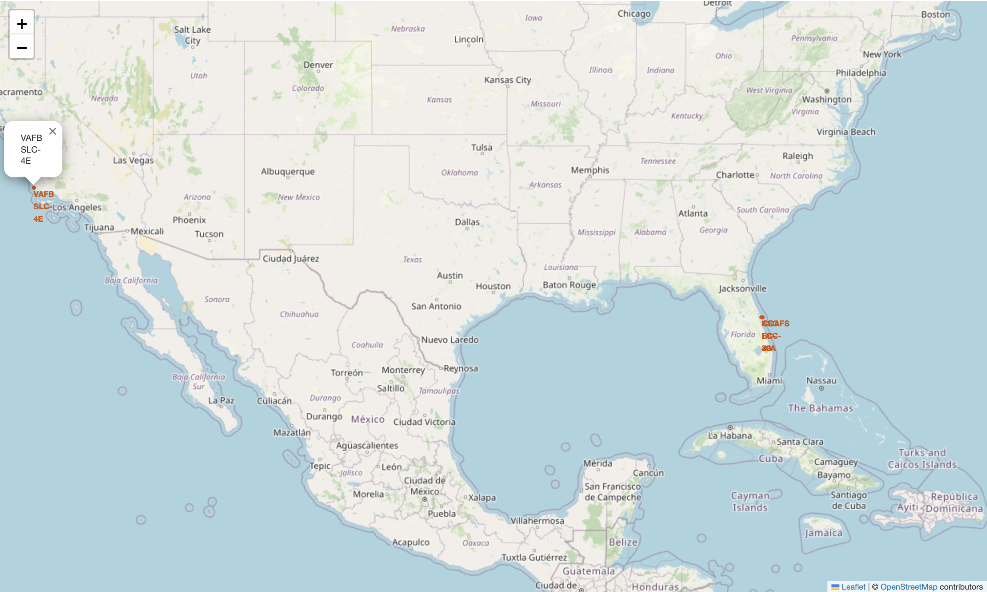
Folium: launch site locations
Locations are marked using circles and markers (launch site names)
Clicking on the circles shows popups with launch site names

Slide 38
Folium: launch sites’ mission outcomes
We add multiple icons at once using marker clusters, choosing the color depending on mission outcome
Popup items contain launch site name and mission outcome

Slide 39
Folium: launch site and proximities
We draw a poly line from the launch site location to a nearby point of interest (e.g. coastline)
The locations are obtained by adding a mouse position tracker to the map to read latitude and longitude on the top right
We then add a marker at the coastline to display the distance from the launch site

Slide 40

Section 4

Slide 41
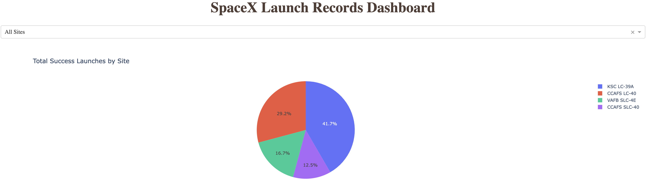
Launch success: all sites
Selection is done through the dropdown menu on top
KSC LC-39A is the most successful launch site (with 41.7% of all successful launches), followed by CCAFS LC-40 (with 29.2%)

Slide 42
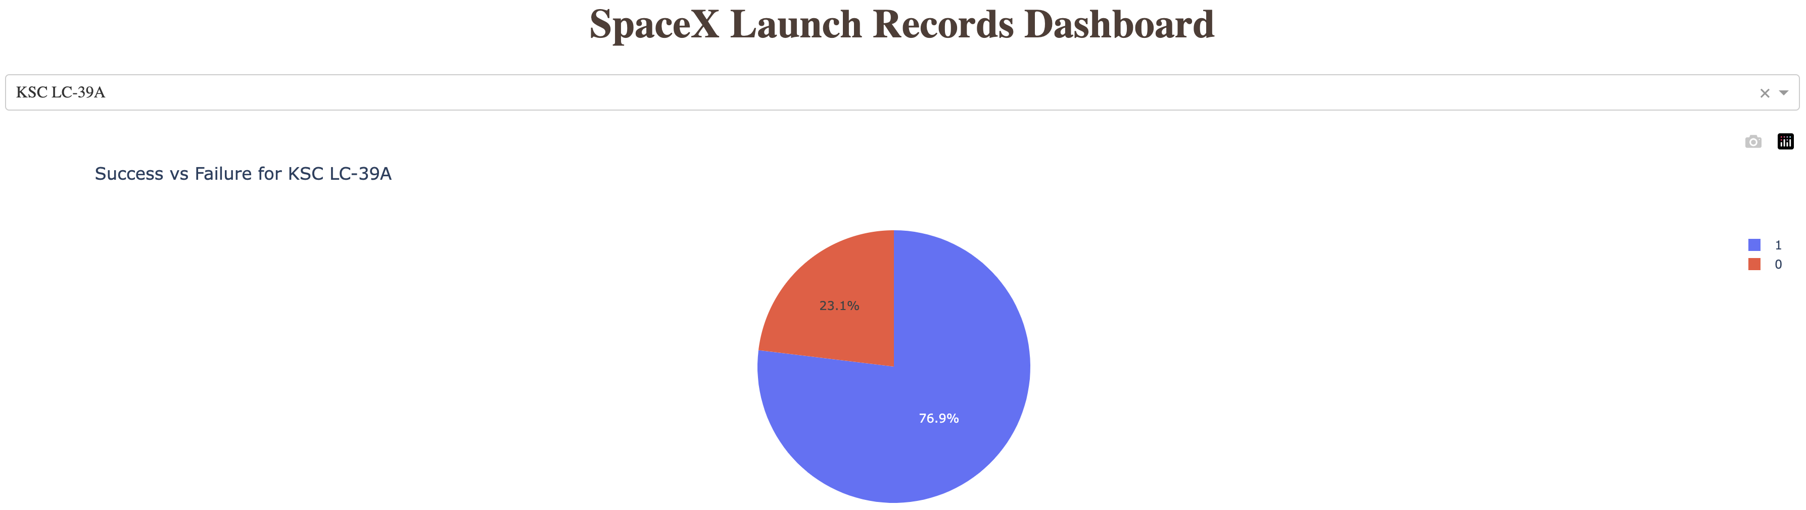
Launch success: best site
Success rate of launch site KSC LC-39A is 76.9%

Slide 43
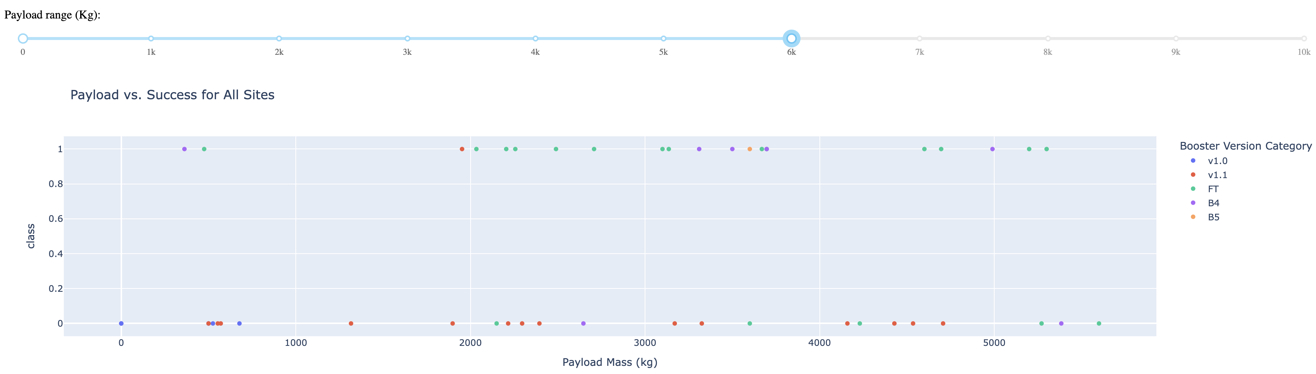
Payload vs. Launch outcome for all sites
Above a payload mass of 6000 kg, the success rate is very low, so we omit it from the chart
The most successful range is 2000-4000 kg
The most successful booster version is FT

Slide 44

Section 5

Slide 45
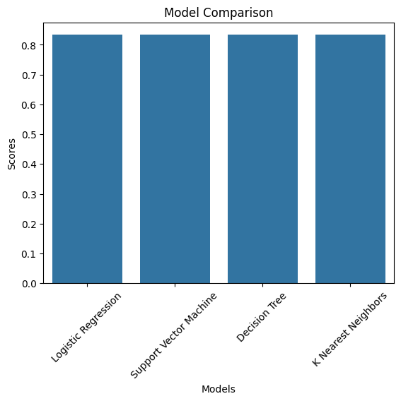
Classification Accuracy
All models have the same classification accuracy of 83.33%, so any of these is a good choice

Slide 46

Confusion Matrix
The confusion matrix is the same for all models
The only problem is false positives (3 out of 15, i.e. a false positive rate of 20%)

Slide 47
Conclusions
Identifying best data sources is crucial to the entire workflow
Structuring data in proper format, including feature engineering, enables effective analysis
Several channels of analysis are useful: data visualisation, database queries, interactive visualisation (maps and dashboards), and predictive analytics with machine learning
If the problem is not complex, several machine learning models may be a viable choice
The data science workflow is iterative, with subsequent improvements based on feedback collected at different stages

Slide 48
Appendix
Include any relevant assets like Python code snippets, SQL queries, charts, Notebook outputs, or data sets that you may have created during this project
select distinct “Launch_Site” from SPACEXTABLE;
select * from SPACEXTABLE where “Launch_Site” like 'CCA%' limit 5;
select sum("PAYLOAD_MASS__KG_") as total_payload_mass from SPACEXTABLE where "Customer" = 'NASA (CRS)’;
select avg("PAYLOAD_MASS__KG_") as average_payload_mass from SPACEXTABLE where "Booster_Version" = 'F9 v1.1’;
select min(Date) as earliest_success_ground_pad from SPACEXTABLE where "Landing_Outcome" = 'Success (ground pad)’;
select distinct “Booster_Version" from SPACEXTABLE where "Landing_Outcome" = 'Success (drone ship)’ and PAYLOAD_MASS__KG_ BETWEEN 4000 and 6000;
select (select count("Mission_Outcome") from SPACEXTABLE where "Mission_Outcome" like 'Success%') as successful_missions, (select count("Mission_Outcome") from SPACEXTABLE where "Mission_Outcome" like 'Failure%') as unsuccessful_missions;
select “Booster_Version" from SPACEXTABLE where PAYLOAD_MASS__KG_ = (select max(PAYLOAD_MASS__KG_) from SPACEXTABLE);
select substr(Date, 0, 5) as launch_year, substr(Date, 6, 2) as launch_month, “Booster_Version", “Launch_Site", “Landing_Outcome" from SPACEXTABLE where substr(Date, 0, 5) = ‘2015' and "Landing_Outcome" = 'Failure (drone ship)’;
select "Landing_Outcome", count(*) as outcome_count from SPACEXTABLE where Date between '2010-06-04' and ‘2017-03-20' group by “Landing_Outcome" order by outcome_count desc;

Slide 49


